Slide 1
SS ZG 526: Distributed Computing
Agreement/ Consensus Problem in Distributed Systems
Chittaranjan Hota
Professor, Dept. of Computer Sc. & Information Systems
BITS, Pilani Hyderabad Campus, Hyderabad
hota@hyderabad.bits-pilani.ac.in

Slide 2
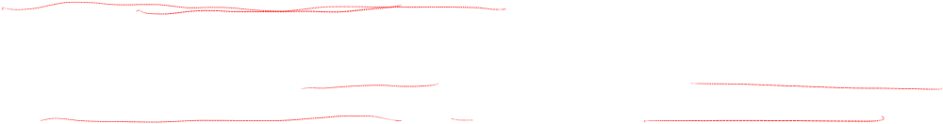
Agreement Protocols
  Have you ever wondered why vendors of (distributed) software solutions always only offer solutions that promise 94% reliability, 98% reliability, … but never 100% reliability?
  The fault lies in the impossibility of consensus
When distributed systems engage in cooperative efforts like enforcing distributed mutual exclusion algorithms, processor failure can become a critical factor.
Processors may fail in various ways, and their failure modes are central to the ability of healthy processors to detect and respond to such failures.
Birla Institute of Technology and Science, Pilani (Deemed University)

Slide 3


What happened at Byzantine?
May 29th, 1453
The Turks are besieging the city of Byzantine by making a coordinated attack.
Goals
  Consensus between loyal generals
  A small number of traitors cannot cause the loyals to adopt a bad plan
  Do not have to identify the traitors
Birla Institute of Technology and Science, Pilani (Deemed University)

Slide 4
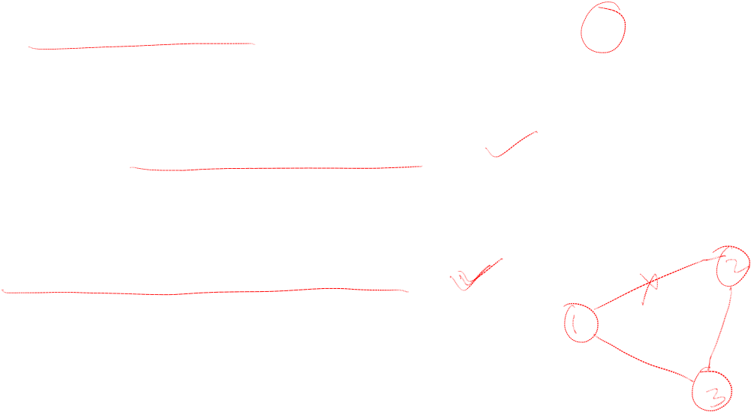
Agreement Protocol: The System model
The are n processors in the system and at most m of them can be faulty
The processors can directly communicate with other processors via messages (fully connected system)
A receiver computation always knows the identity of a sending computation
The communication system is reliable
Birla Institute of Technology and Science, Pilani (Deemed University)

Slide 5

Communication Requirements
Synchronous communication model is assumed in this section:
  Healthy processors receive, process and reply to messages in a lockstep manner
  The receive, process, reply sequence is called a round
  In the synch-comm model, processes know what messages they expect to receive in a round
The synch model is critical to agreement protocols, and the agreement problem is not solvable in an asynchronous system
Birla Institute of Technology and Science, Pilani (Deemed University)

Slide 6

Processor Failures
Crash fault
  Abrupt halt, never resumes operation
Omission fault
  Processor “omits” to send required messages to some other processors
Malicious fault
  Processor behaves randomly and arbitrarily
  Known as Byzantine faults
Birla Institute of Technology and Science, Pilani (Deemed University)

Slide 7
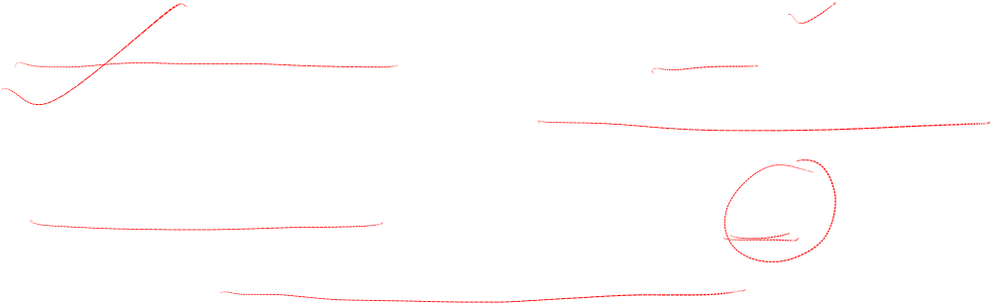
Message Types
Authenticated messages (also called signed messages)
  assure the receiver of correct identification of the sender
Non-authenticated messages (also called oral messages)
  are subject to intermediate manipulation
Birla Institute of Technology and Science, Pilani (Deemed University)

Slide 8
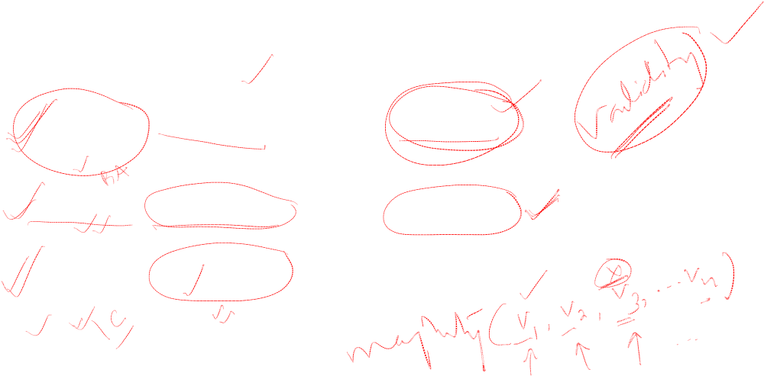
Agreement Problems
Problem Who initiates value Final Agreement
Byzantine One Processor Single Value
Agreement
Consensus All Processors Single Value
Interactive All Processors A Vector of Values
Consistency
Birla Institute of Technology and Science, Pilani (Deemed University)

Slide 9

Next session
Lamport-Shostak-Pease Oral Message Algorithm for BA
Birla Institute of Technology and Science, Pilani (Deemed University)

